Slide 1
Resume 101
Transitions & Pathways Unit
This Photo by Unknown Author is licensed under CC BY-SA-NC

Slide 2
What is a Resume?
A resume is a formal document that displays an individual's professional background and relevant skills

Slide 3
What does a Resume contain?
Personal Contact Information
Education
Awards/
Activities
Skills
Objective
Experience

Slide 4
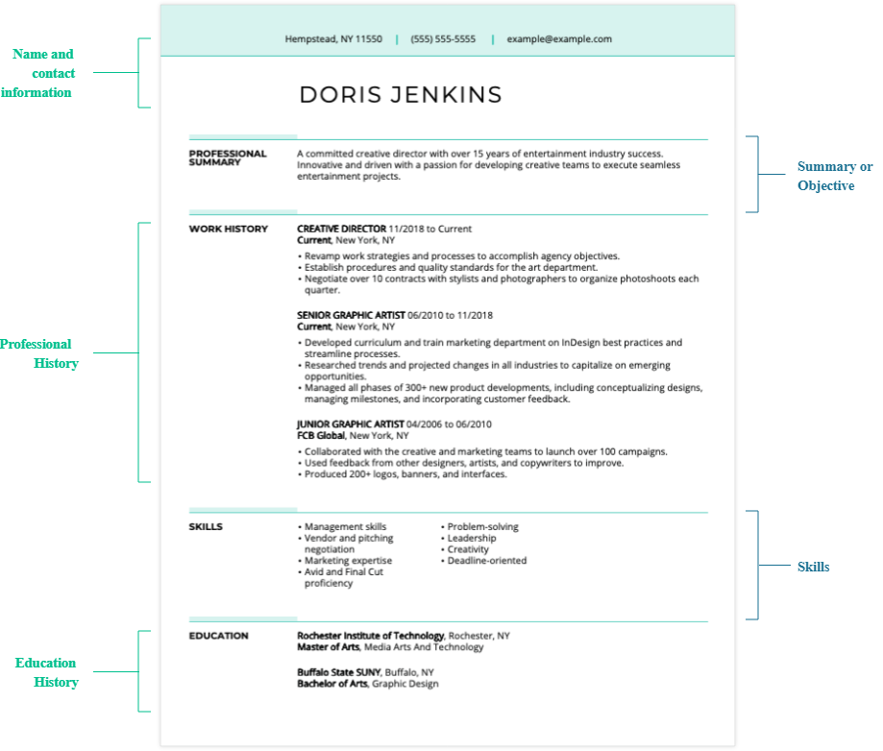
3 Types of Resume Formats:
Chronological resumes are best for people who have a strong work history.
Chronological:
Lists your professional experience in reverse, beginning with your most recent position and continuing in descending order.
Then proceed with your Education/Certifications and Skills.

Slide 5
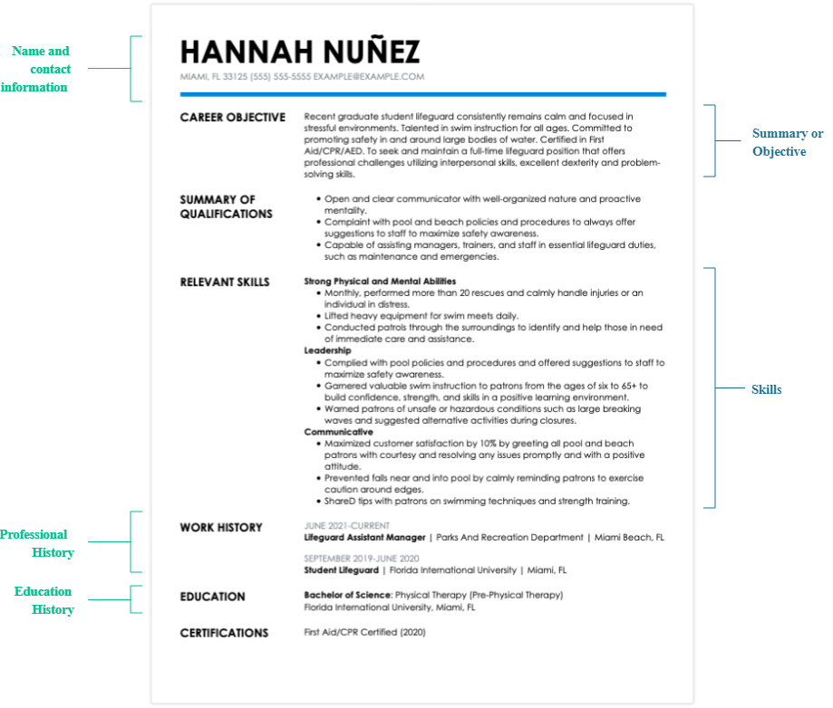
3 Types of Resume Formats:
This allows employers to focus on the candidate’s qualifications such as any technical or soft skills required for the job.
Functional or Fresher:
Focus is on skills and achievements.
Showcases skills and strengths that are important to employers.
Minimal dates, names, and places.
This is great to use when you are changing careers within your profession, recent graduate, gaps in your employment history, or gained skills and experience through school or mentorships.

Slide 6
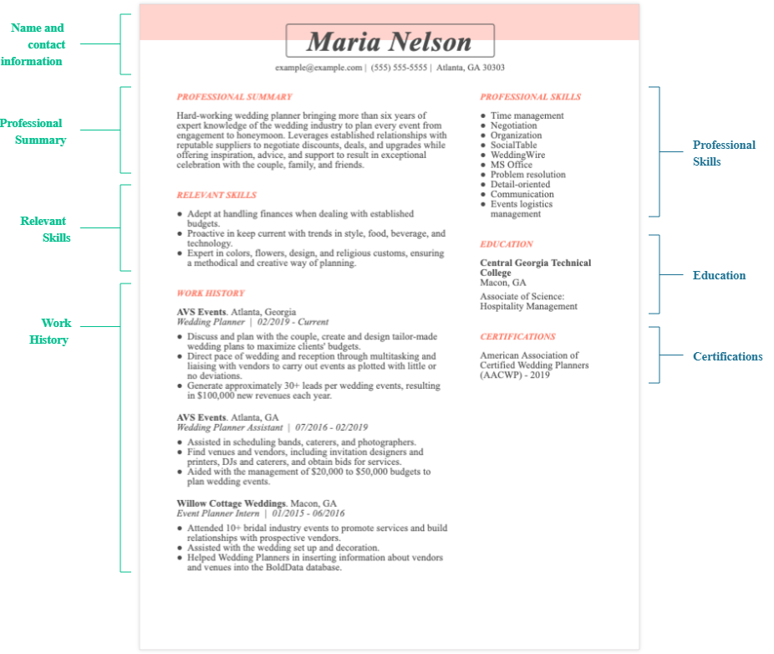
3 Types of Resume Formats:
Combination/ Hybrid:
Best for resumes that outline diverse skill sets.
Blends the flexibility and strength of the other two types of resumes.
Relevant skills and abilities are listed first
Continues with chronological experience
This resume format is good for emphasizing specific skills and abilities of professionals with diverse backgrounds and creative applicants like designers or artists.

Slide 7
Tips & Tricks to a GREAT RESUME.
Limit to one to two pages.
Times New Roman or Arial
Two to Three Font sizes on your Resume (NAME/ SECTION/ SUMMARY)
Emphasize leadership positions, involvement in student bodies, and volunteer engagements.
Only use the last 10 years of work experience.
Include relevant work experience aligned to the job you are applying for.
Detail previous experiences, including job roles, internships, and significant projects.
Use action Verbs and avoid long paragraphs
Mention any highlights, achievements, or study abroad experiences.
NOTE: Always have a general Resume and use it as a foundation to develop additional resumes based on jobs you apply for. CHANGE YOUR RESUME FOR EACH JOB APPLICATION.

Slide 8
Knowing The Resume Mistakes
Avoid these cringe-worth resume mistakes:
Incorrect contact information
Unprofessional email addresses
Outdated objective statements
Spelling and grammatical errors
Lack of specifics and action verbs
Too much or too little information
Lies and exaggerations
Too much personal information
Not matching your resume with your actual job application

Slide 9
Resume Order:
A resume must be organized in an order to demonstrate your ability to develop a professional document.
Resume Chronological Order:
Contact Information
Objective or summary
Education
Experience
Leadership/ Skills
There is no RIGHT or WRONG Resume! Only an organized Resume.

Slide 10
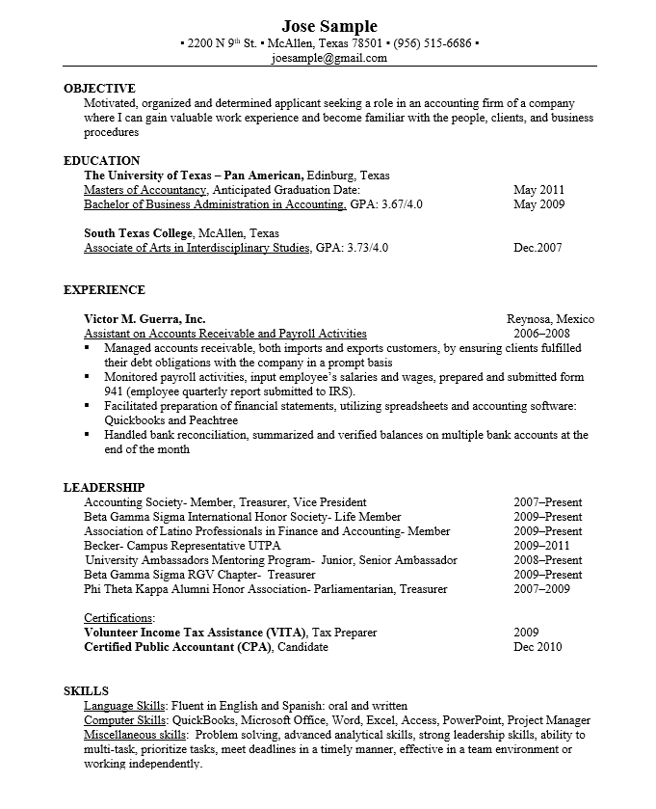
Resume Sample:
This Photo by Unknown Author is licensed under CC BY-SA-NC

Slide 11
Crafting: Contact Information/ Header
The resume header section appears at the top of the resume and includes your name and contact information.

Slide 12
Crafting: Objective
Objective or Summary: An objective/Summary is a brief statement that communicates your career goals, such as the type of job or industry you want to work in or skills you want to build.

Slide 13
Crafting: Objective
Objective or Summary
Why Should I Include a Objective/Summary?
Objective statements can help hiring managers quickly review your resume and determine if you’re a good fit for the role.
Here are a few tips to remember:
Study that Job Description
Identify YOUR unique qualities
Short and Simple makes a difference
Place it at the top or your Resume
What If I Exclude the Objective/Summary?
Not everyone includes an objective statement on their resumes. Here are some ideal times for including an objective statement on your resume:
You’re an entry-level candidate with little professional experience.
You recently moved to a new location.
You have decided to make a career change.
In these scenarios, including an objective statement allows you to offer a sum of your qualifications, skills and abilities as they relate to the open role.

Slide 14
Resume Objective:
Get noticed, use keywords, and highlight your strengths in a sentence or two.
https://youtu.be/BxPy_-cl4mY

Slide 15
Crafting: Education
An education summary is the section of your resume where you highlight your academic qualifications and achievements. If you don't have work experience, this part of your resume will be important. It will be the are to help convince employers you can succeed on the job.
You can place your Education after Objective, UNLESS you're a recent graduate, you can place your education section at the bottom of a chronological resume. In this space, you can provide details about your highest level of education.

Slide 16
Crafting: Experience
The work experience section in your resume shows the hiring manager whether you have the necessary experience and skills to succeed in the role you are applying for. This section also includes information about your achievements, which can distinguish you from other applicants and make you more likely to get an interview.
NOTE: Make sure you organized them in order of events, in CHRONOLOGICAL ORDER with your most recent job at the top.
Experience includes details about each job, internship, or volunteer experience you've had and your duties or accomplishments in those roles.
Companies you have worked for
Locations of the companies
Employment Dates
Job Titles
Responsibilities

Slide 17
Crafting: Soft & Hard Skills
It may include both technical (hard) skills, such as project management or coding, and other interpersonal/social (soft) skills, such as communication and organization.
Organize your skills on a resume by listing your most job-relevant abilities at the beginning of your skills section. This means:
You will place your technical (hard) skills before your interpersonal (i.e., soft) skills.
The employer will now be able to see your job-related skills in order of proficiency.
After you have listed the job-specific skills you have to offer, you can then include the skills that are directly related to your personality and work ethic.
https://youtu.be/_bZi-34IFxs

Slide 18
Crafting: Leadership Skills
Schools offer organizations that students can join to develop skills and interact with their classmates. If you participated or plan to participate in extracurricular activities in school or have volunteered, it may be beneficial to explain your experiences on your resume.
Make sure you include any leadership roles such as team leaders, trainers, captains, supervisors, President of organizations.
Helpful Tips:
Make sure you demonstrate your technical skills
Emphasize on leadership skills that you’ve gained from organization or event.
This can help out in filling any extra space that is short on professional experience.

Slide 19
Remember:
There is no right or wrong when it comes to resume content and format.
Each resume is as unique as the individual it represents. It is up to you to select the appropriate details that best highlights YOUR skills for the employment YOU hope to obtain.
Make sure you communicate your qualifications in a way that is clear and easy to read.
Have at least another person look over it.
Most importantly, take advantage of your FREE Workforce Development Center resources available to our Palominos students and alumni.

Slide 20
THANK YOU!
Feel free to email at denise.flores@laredo.edu
for any questions on Employment and Career Services!
https://laredo-csm.symplicity.com/

